Slide 1
Paradigm Shift : Accessibility, Discrimination and Participation
DR SRUTI MOHAPATRA, VICE CHAIR CDPF
11/09/2024, VIRTUAL

Slide 2
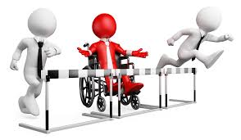
Three Major Shifts
Discrimination
Accessibility
Participation

Slide 4
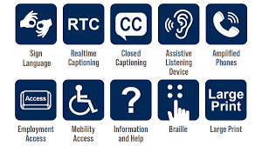
Accessibility For All.
Accessibility Everywhere.

