Slide 1

Accelerating the Achievement of gender equality and empowerment of all women and girls with disabilities
Sixty-Eighth Session of the Commission on Status of Women
11 to 22 March 2024
Sarah Muthoni Kamau, Chair, CDPF

Slide 2
What is Commonwealth Disabled People Forum (CDPF)?
Created in 2019
Membership: organizations of persons with disabilities from 49 countries out of 56 across the Commonwealth
Youth and women with disabilities Forums in place
Conducted Disability Equality trainings during the COVID 2019
Regular virtual regional meetings operational

Slide 3
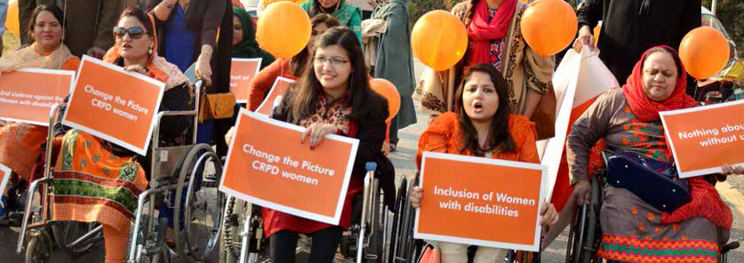
Why disability Inclusive Gender Equality NEEDED?
Because achievement of global agenda depends on how women with disabilities are included in the SDGs.

Slide 4
HOW Achievement of global agenda depends on INCLUSION OF women with disabilities?
The SDG 1 (Poverty) concurs to CRPD 10 Right to life; cannot be achieved until 16% of world population with disabilities are educated and have equal access to economic opportunities
SDG 3 (Good Health and Well being) concurs with CRPD articles; 25 Health, 16 freedom from exploitation, violence and abuse, 21 freedom of expression, 31, 32 International Cooperation
SDG 4 (Quality education) concurs with CRPD 24 Education; Will lag behind until the numbers of young girls and boys with disabilities have access to accessible inclusive education for every child
SDG 5 (Gender Equality) concurs with CRPD Article 6; One woman with disability left behind means one lost opportunity towards achieving SGD 5 Gender Equality indicators.
SDG 8 (Employment and Livelihood) concurs with CRPD Article 27; Will not be achieved unless full and productive employment and decent work for persons with disabilities, and equal pay for work of equal value is achieved.
SDG 10 Reduced inequalities concurs with CRPD 5, Equality and non-discrimination, 9 accessibility, 27 work & employment, 28 adequate standard of living & social protection, 29 political and public life, 31 statistics and data collection.

Slide 5


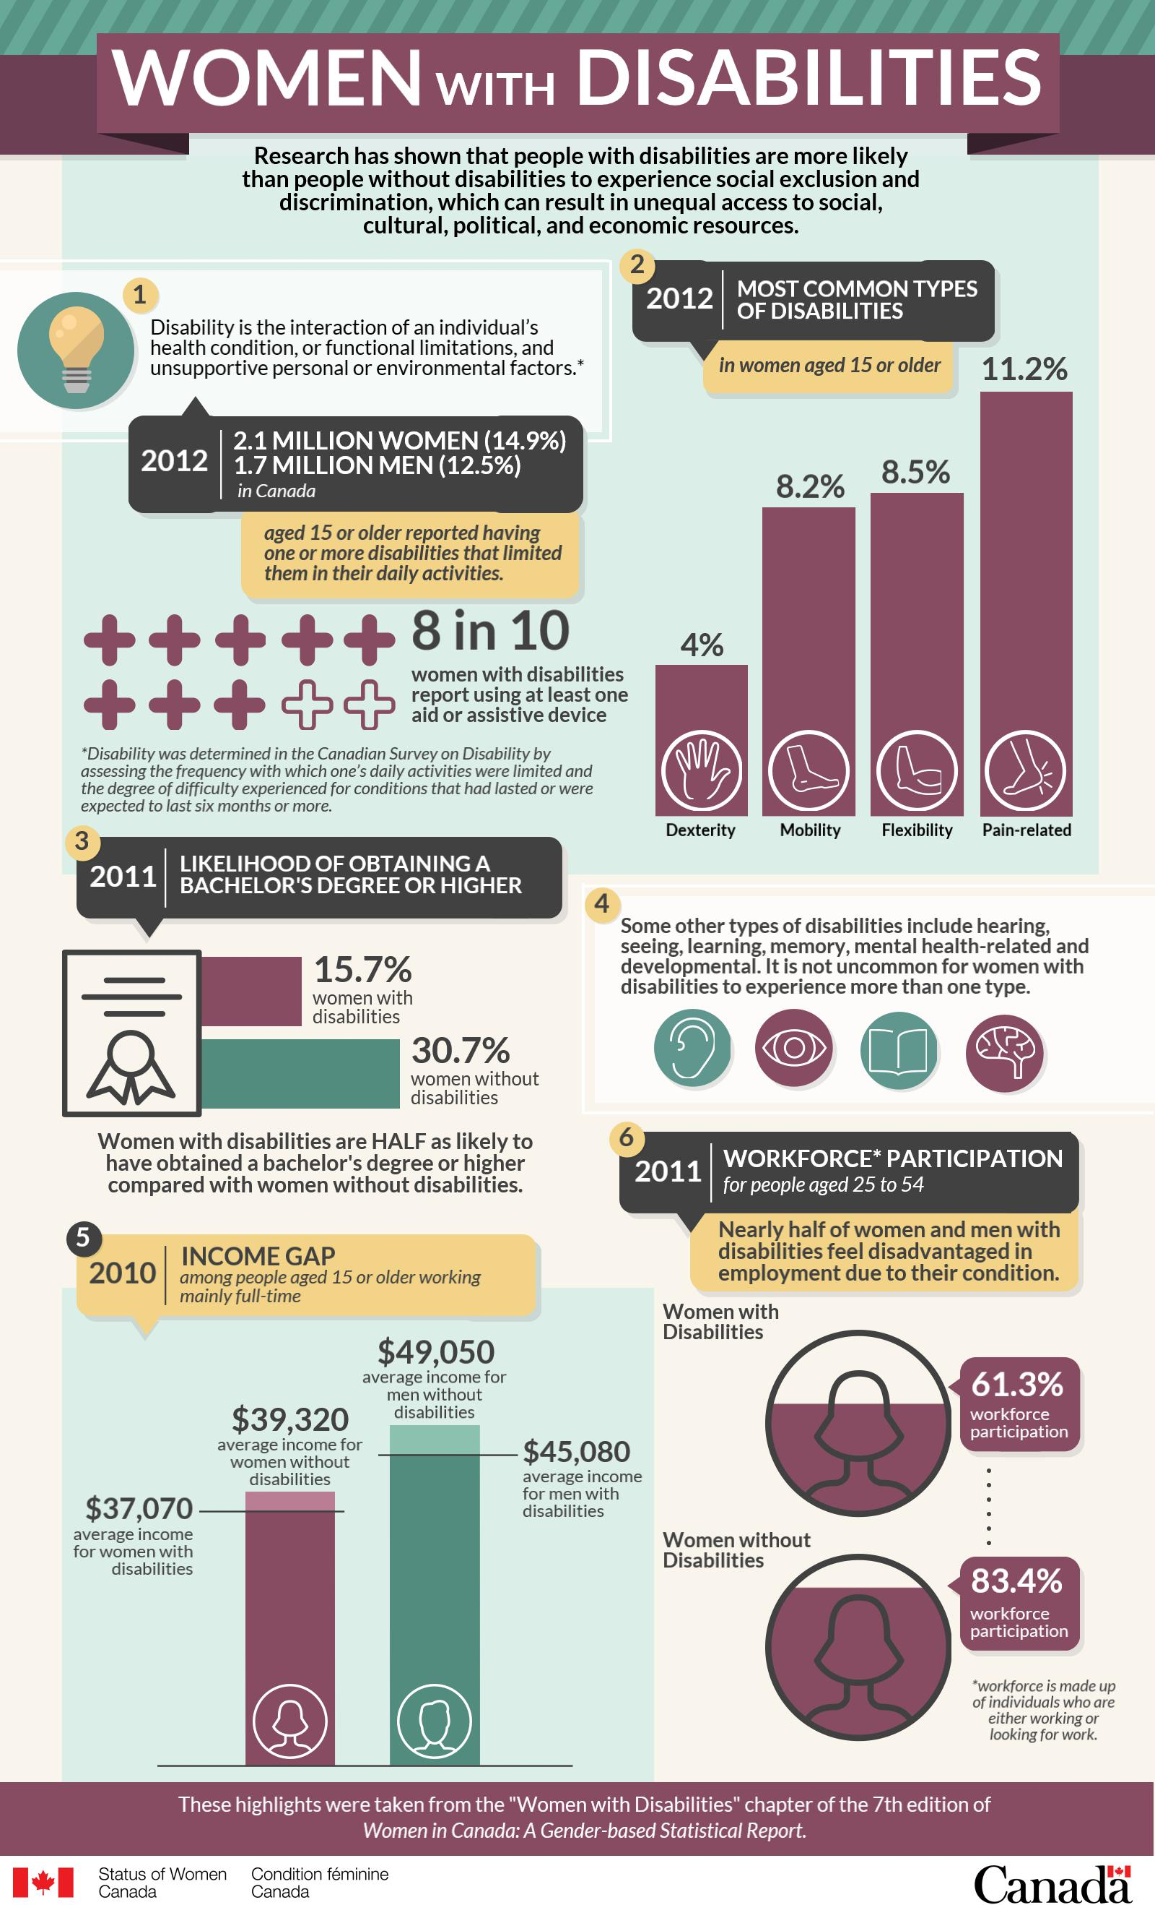
THE GRIM SITUATION

Slide 6


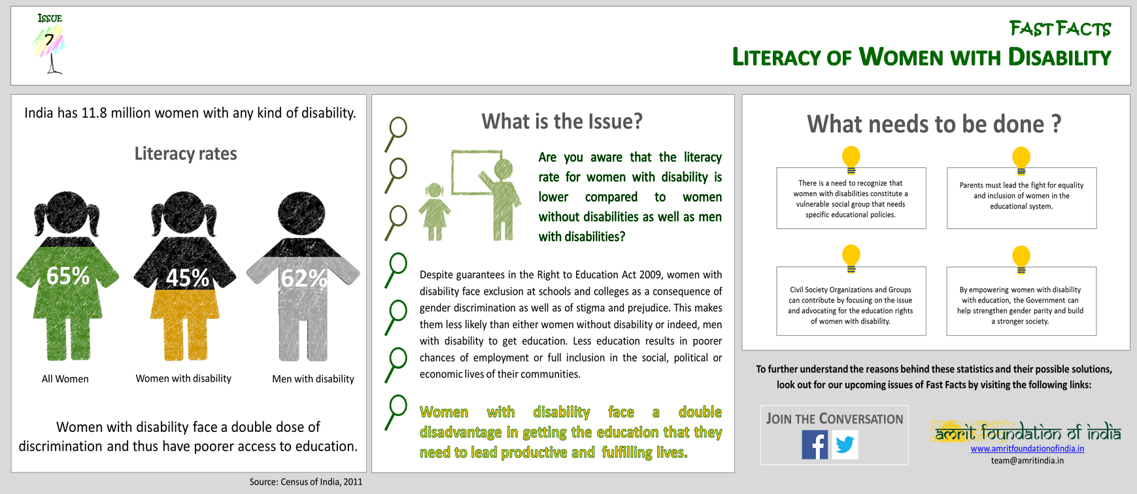

LOW LITERACY

Slide 7

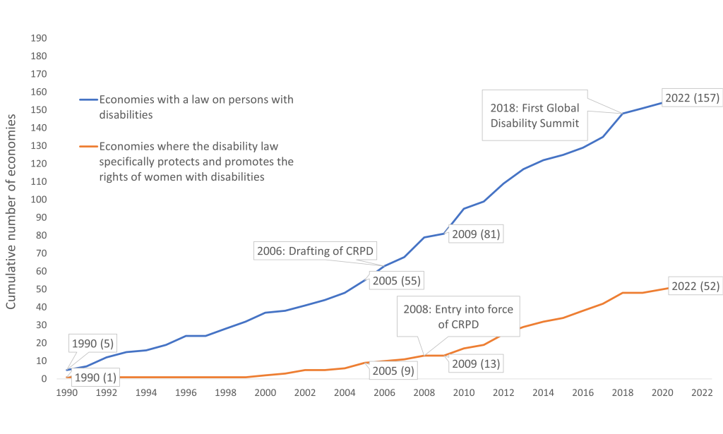
ECONOMIES GROW WHEN RIGHTS OF THE DISABLED, ESPECIALLY WOMEN WITH DISABILITIES, IS PROTECTED BY LAW
Source: Women, Business, and the Law database.
Note: The number of economies with laws are not mutually exclusive, i. e. economies that have laws that specifically protect and promote the rights of women with disabilities are also counted as economies with a law on persons with disabilities. CRPD = United Nations Convention on the Rights of Persons with Disabilities

Slide 8
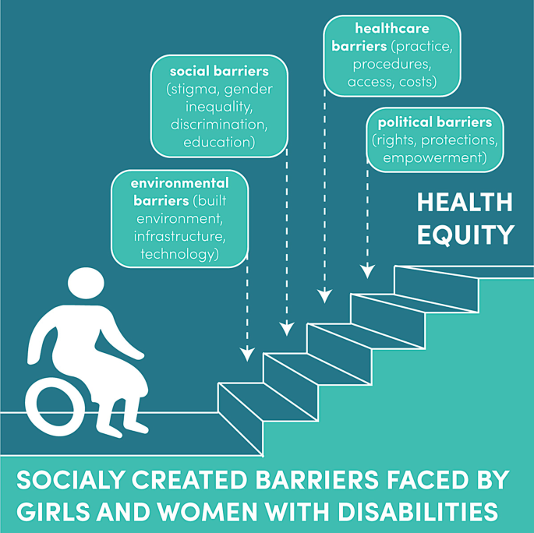
HEALTH INEQUITY

Slide 9
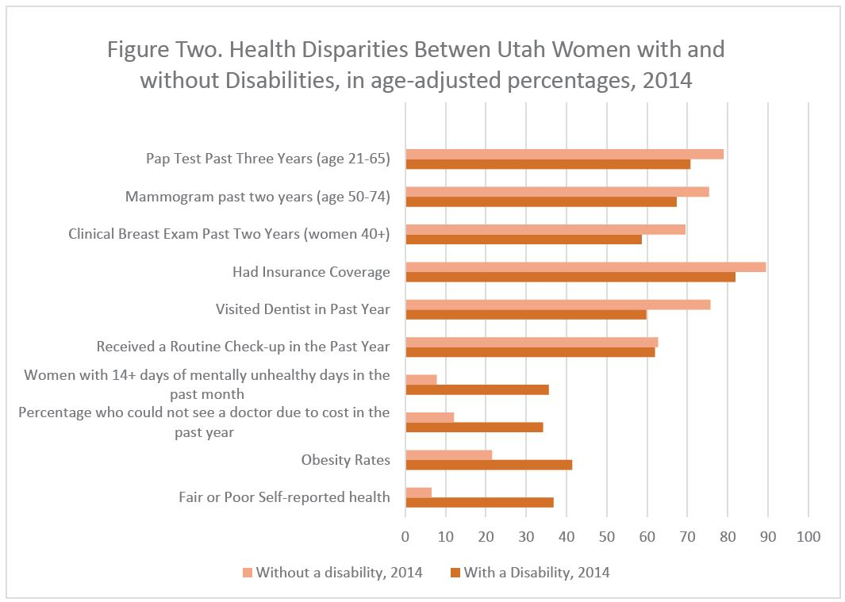
A CLEAR INDICATOR THAT WOMEN WITH DISABILITIES SUFFER ON HEALTH GROUNDS ACUTELY AS COMPARED TO WOMEN WITHOUT DISABILITIES
Source: Women with Disabilities: An Important Health Disparity Population – UWH Review

Slide 10
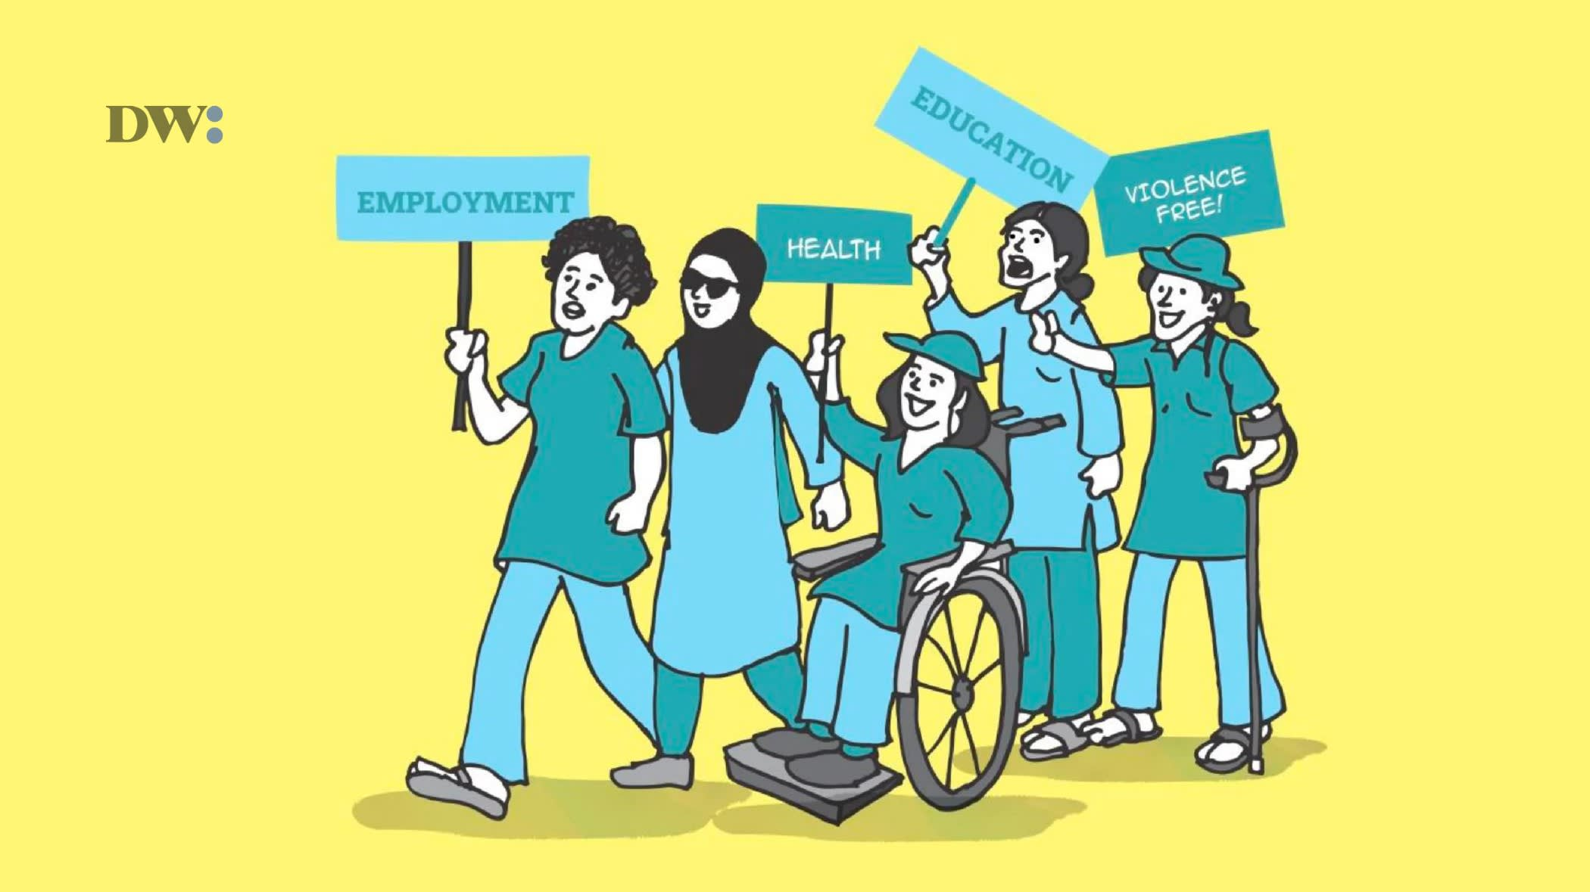
Key Priorities Areas for Action based on DISABLED WOMEN’S VOICES FOR FULL INCLUSION
Education
Employment and Economic Empowerment
Move beyond Gender Equality to promote Gender Equity, - CDPF Disability Inclusion Strategy and Action Plan and call for its adoption during CHOGM 2024
Health Care Services
Political Participation
Cross cutting issues of Gender and Age
Disaggregated data by Gender and Disability - Climate Change Actions
Stigma and Discrimination
Accessibility

