Slide 1
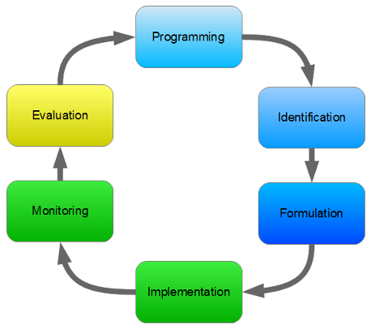

Slide 2
IN A NUTSHELL: BASIC RULES FOR CRPD COMPLIANT BUDGETING
1 DO NOT spend public funds on programs and services that are contrary to the CRPD such as segregated education or social care institutions.
2 ENSURE that all public spending across ministries and levels of government contributes to inclusion, including development assistance:
*accessibility in all publicly funded new infrastructure, transport, information and communication systems
*accessibility requirement in public procurement regulations for services, works and goods
*non-discrimination and duty to provide reasonable accommodation in all public services
*social clause in procurements favouring employment of persons with disabilities.
3 PROGRESSIVELY AND EQUITABLY increase spending to ensure national access to support services that promote inclusion: (re)habilitation, assistive devices, personal assistance, sign language interpreters, support for children and their families, disability allowance, etc.
4 PROGRESSIVELY invest in making existing infrastructure and services accessible to all persons with disabilities.
5 COLLECT AND DISSEMINATE data on budget and outcomes of publicly funded programs and services.
6 CONSULT with DPOs in their diversity across the budget cycle.

Slide 3
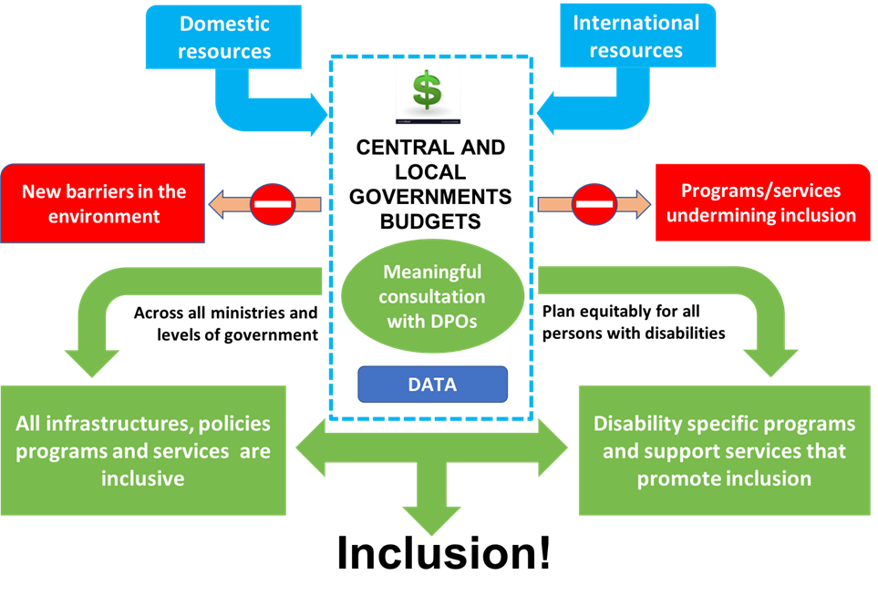
- Basic principles of budgeting for inclusion of persons with disabilities

