Slide 1
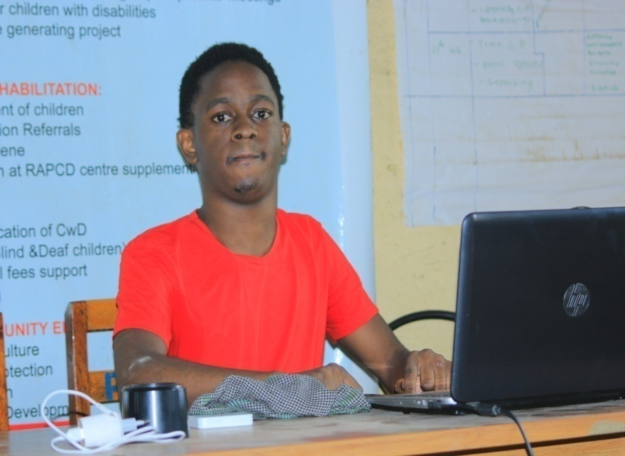
LADIES AND GENTLEMEN, ESTEEMED DELEGATES, AND FELLOW ADVOCATES,
Greetings from the heart of Uganda to the vibrant city of London, where we gather under the banner of the 10th Commonwealth Youth Ministers' Meeting, hosted by the gracious government of Pakistan.
My name is KIHEMBO WILBERT, and I am deeply honored to stand before you as a Youth Representative for the Commonwealth Disabled People's Forum.
In the tapestry of life, we each carry our own threads of challenges and triumphs. Today, I share my thread - a thread woven with the complexities of Cerebral Palsy and speech impairments. Each day, I navigate a world where communication is a mountain to climb, where my voice, though silent, yearns to be heard by my friends, classmates, lecturers, and everyone around me.

Slide 2
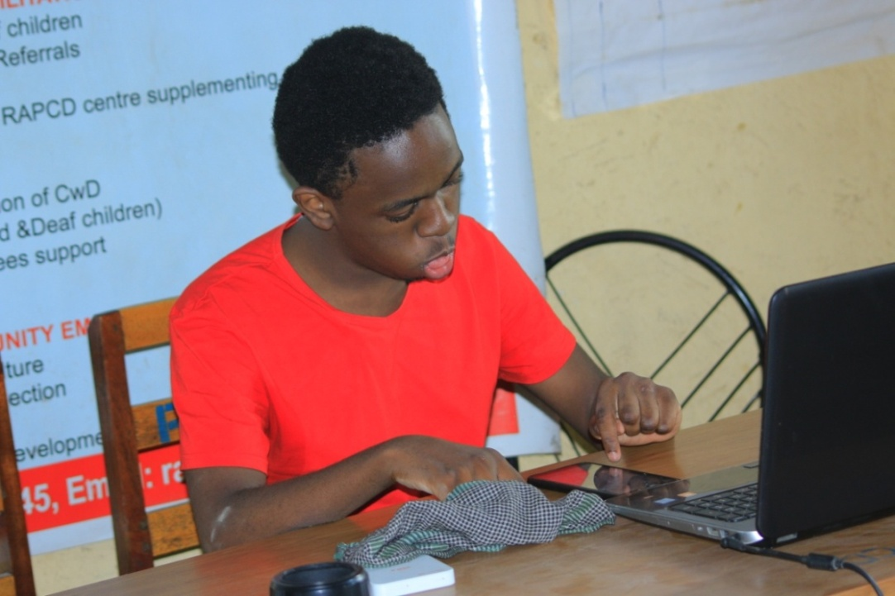
Imagine the frustration of having a symphony of thoughts and emotions, yet being silenced by the constraints of our physicality. Imagine the isolation of watching our friends engage in lively conversations, while we remain locked in a world of unspoken words. Our voices are like birds trapped in cages, fluttering desperately against the confines of circumstance. But let me tell you this: within those cages, our spirits are unbreakable, our determination unyielding, and our potential immeasurable.
In this room, where decisions are made, futures are shaped, and dialogues are ignited, there exists an opportunity - a profound opportunity to bridge the gap that has left individuals like me underrepresented for far too long. These communication barriers, erected by circumstance
rather than choice, have led to a painful reality - one where our perspectives, our insights, and our dreams often go unnoticed, unheard, and untapped.

Slide 3
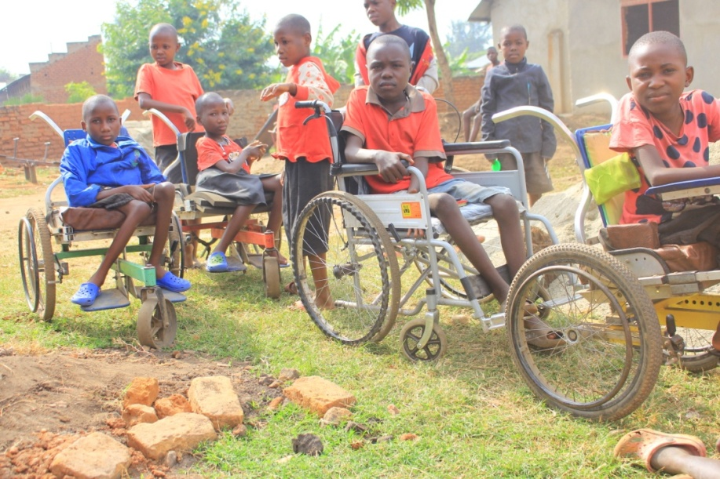
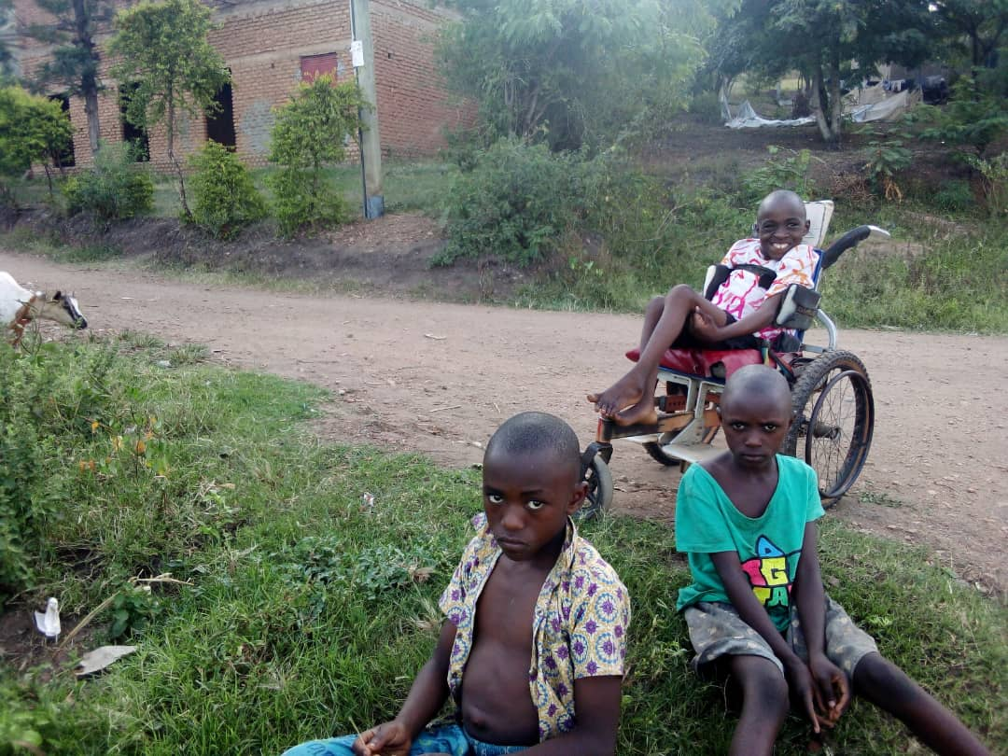
As we approach the culmination of the Year of Youth 2023, declared by the Commonwealth heads of state, I stand before you as an advocate, a catalyst for change and a voice for those whose words struggle to cross their lips. It is a call to action - a call that resonates beyond these walls and across the continents.
Governments, stakeholders, DPOs - it is our collective responsibility to amplify these silenced voices. Let us weave inclusion into the fabric of our societies, ensuring that individuals with speech impairments are not merely spectators, but active contributors to the conversations that shape their lives
The Year of Youth 2023 is a testament to their recognition of the pivotal role young people play in shaping our shared future. But let us not forget that this future must be shaped inclusively, encompassing the ideas and aspirations of everyone, irrespective of their ability to speak conventionally.

Slide 4
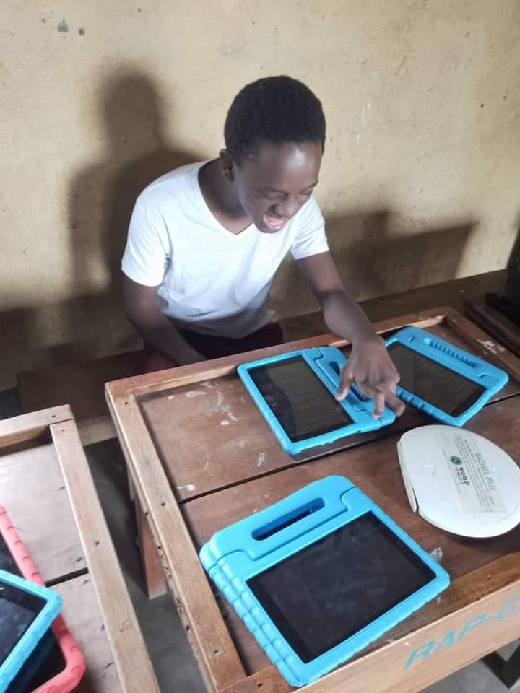
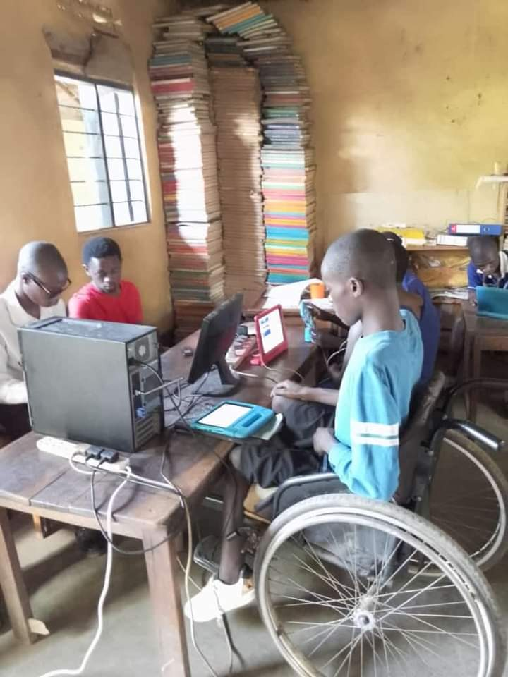
As the Commonwealth Disabled People's Forum, we have embarked on a mission to amplify these voices, to ensure that the world recognizes the richness of perspectives that often remain hidden. Our disabled youth manifesto echoes with the unwavering belief that every individual,
regardless of their abilities, deserves the right to be heard. We stand as advocates for inclusion, as champions of equality, and as torchbearers of change.
The power of assistance technologies is a beacon of hope in this endeavor. With each keystroke, every gesture recognized, and through the marvel of innovation, our voices can break free. But it is not just technology; it is the embodiment of empathy, the embodiment of progress.
I beseech you to carry forward this message, to be ambassadors of change within your spheres of influence. Let us ensure that as we march towards the future, it is a future where no voice is left behind, no idea unexplored, and no potential untapped.

Slide 5
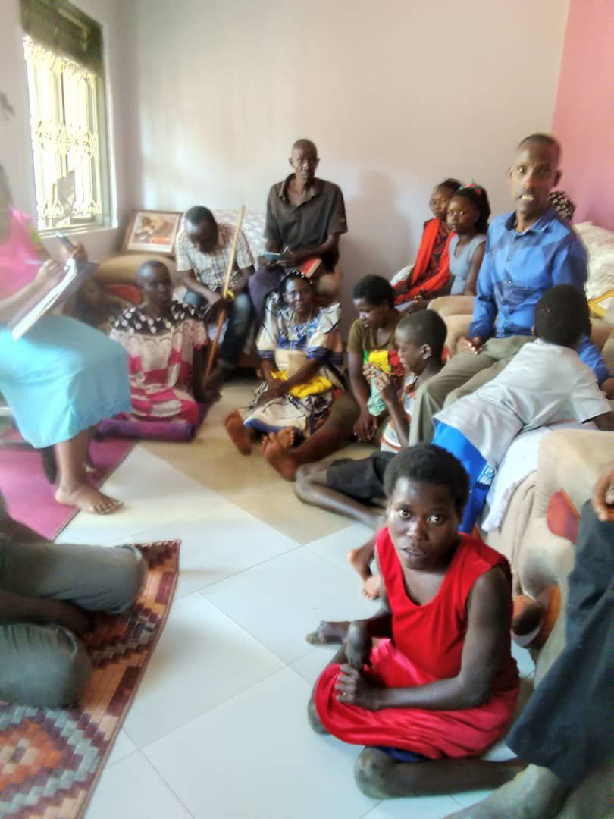
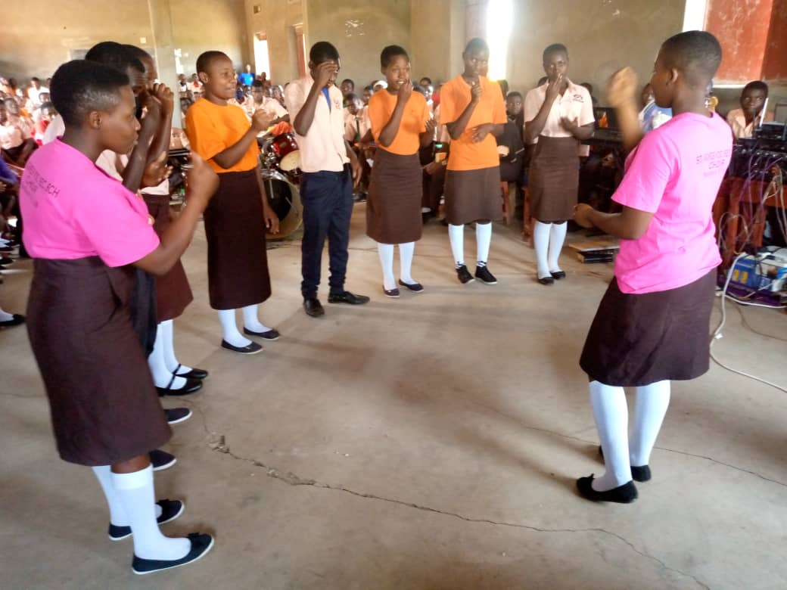
In closing, I extend my heartfelt gratitude to the organizers, to the governments, and to each one of you who took a moment to lend an ear to a voice that often goes unheard. As we wrap up this crucial assembly, let us leave here not just with resolutions, but with a renewed commitment to champion inclusion, to champion unity, and to champion the rights of every individual, regardless of their abilities.
Thank you, and may our collective efforts pave the way for a world where every voice resonates, where every heart is understood, and where the power of unity propels us towards a brighter and more inclusive tomorrow.

