Slide 1




CDPF On-line Disability Equality Capacity Building
Course 2021
On - line Presentation
Module 4 - Innovation Access & Assistive Devices
Commonwealth
Disabled People’s Forum
Presenters
Richard Rieser General Secretary r.rieser@gmail.com
Sarah Kamau Acting Chair CDPF, United Disabled Persons Kenya ,
Nathalie Murphy CDPF Exec., Caribbean, Steve Estey CDPF Exec., Canada Dickson Mveyange, CDPF Exec., Tanzanian Association of the Deaf
Supported
& Funded by

Slide 2
Introduction
A fundamental human right is for disabled people to gain access and participation on an equal level with others regardless of our impairments.
Disabled people have struggled for many years to adapt society’s lived physical and information environment for this to happen.
The first International Human Rights Treaty to explicitly mention it was the UN Convention on the Rights of Persons with Disabilities (UNCRPD), 2008
There had been Clauses in previous Treaties, National Laws, building codes and standards that had partially acknowledged the need for access in the previous 120 years. All of these were fought for by disabled people and their organisations and some non-disabled led charities.
People with sensory impairments were in the vanguard arguing for the teaching and use of Braille, Sign Language, gaining concessions in a minority of countries, usually higher income.
UNCRPD & Article 9 establishes binding obligations for States and consequently, rights for persons with disabilities that are not included in the other core human rights treaties.

Slide 3
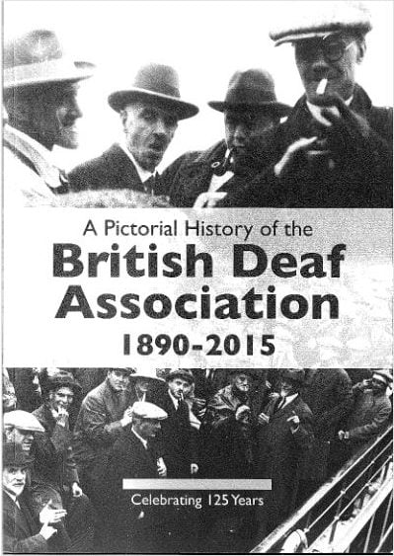
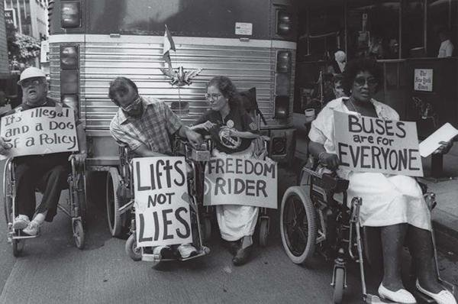
Introduction- 2
The provision of these means of communication were often provided in segregated, sometimes residential schools, colleges and ‘sheltered’ workplaces. The built environment, transport, libraries, shops, hospitals, schools, colleges, universities, housing, places of entertainment and political processes, indeed all of ‘normal’ human life, was not adapted for disabled people to take part.
Where possible we had to be rehabilitated to be as ‘normal’ as possible. These moves were usually led by non-disabled medically trained rehabilitation professionals and they and some disabled people faced with the huge number of barriers in the environment, designed a wide range of assistive devices to make living in an inaccessible world easier.
The idea that built environments, transport and systems of communication must be adapted and renewed universally designed, so there are no barriers, gained support in the last 50 years as disabled people and Disabled People’s Organisations (DPOs), became better at expressing our goals through ‘social model’ thinking.
This set the stage for the UNCRPD and the incorporation of the ideas and principles into the Sustainable Development Goals (SDGs e.g.11.2 and 11.7).

Slide 4
Introduction 3
The current COVID-19 pandemic has tested the robustness of our societies and how have incorporated these principles into our day to day activities and they have been wanting. Around the world and across the Commonwealth, our DPOs have had to push Government to provide Signed announcements and information, to provide essential information in Easy Read and pictograms.
Those who are literate with information technology and who are Blind or visually impaired have been able to benefit from the availability of access programmes, text to speech. IT operating systems have shown the way forward as such adaptions are now standard on I-pads, Lap-Tops and Smart Phones.
Many millions of disabled people have n access to these systems.
All the surveys by DPOs show that mental anxiety has risen across disabled people, especially those with psycho-social conditions. This tells us that Access is not just about communicating a message but how the message is communicated and how disabled people are supported.
As we ‘Build Back Better’ there has never been a better time to argue for Access and the provision of assistive technology, to avert the colossal wastage of human potential and pain that a ‘business as usual’ approach will mean for the world and its disabled inhabitants. We know how to do this better. Let us put it into practice for all our sakes.

Slide 5
The Language the CDPF use
Disabled people: Why we still choose to call ourselves ‘disabled people’: In the Commonwealth Disabled People’s Forum (CDPF) we call ourselves ‘disabled people’ because of the development of the ‘social model of disability’.
In the C19th and C20th, a disabled person’s medical condition was thought to be the root cause of their exclusion from society, an approach now referred to as the ‘medical or individual model’ of disability. We use the ‘social model of disability’, where the barriers of environment, attitude and organisation are what disable people with impairments and lead to prejudice and discrimination.
So to call ourselves ‘persons with disabilities’ is to accept that we are objects and powerless. We also view ourselves as united by a common oppression so are proud to identify as ‘disabled people’ rather than ‘people with disabilities’.
When we are talking about the UN Convention on the Rights of Persons with Disabilities we will use ‘people or persons with disabilities’.

Slide 6
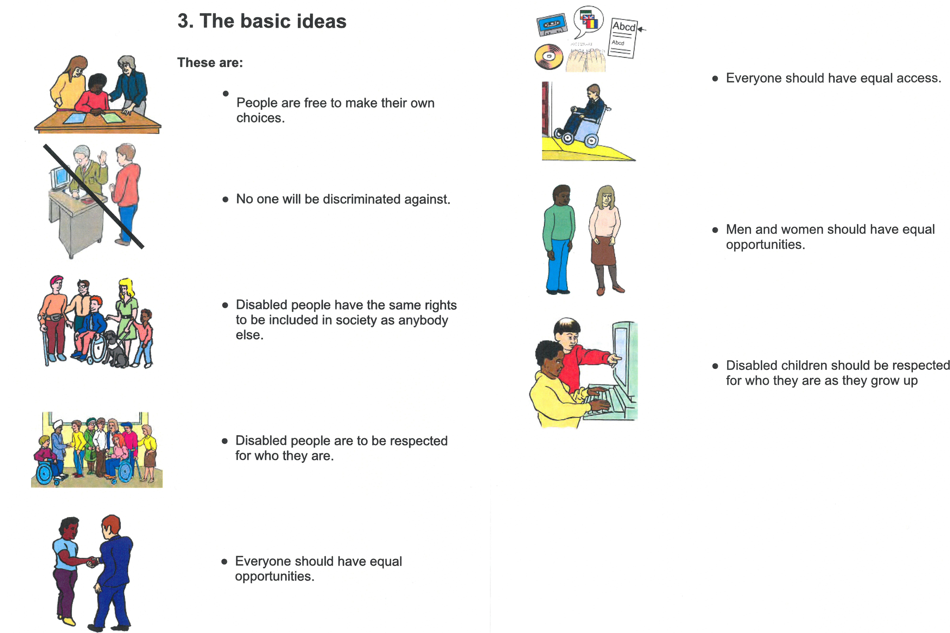
UNCRPD Principles
Easy Read

Slide 7
Accessibility
One of the key thrusts of the UNCRPD is to create accessibility by universal design and accessibility standards. Accessibility is a human rights principle running throughout the convention. “Inaccessibility: discrimination and freedom of movement/independent living. Physical, informational and technological barriers prevent persons with disabilities from fully participating in society on an equal basis with others. Inaccessibility also relates to negative attitudes in society that perpetuate images of persons with disabilities as being slow, less intelligent or unable to make decisions, for example. A key element to ensure equal rights for persons with disabilities is improving the accessibility of the built environment, information and communications technology, transport and other facilities, goods and services open to the public”.
A Twin Track approach is taken to Access in the UNCRPD. It is a principle(art.3), It has a stand alone Article 9 and comes up in all articles ‘being treated on equal basis to others’ and specifically in Articles 20 Personal Mobility , Article 21 Freedom Expression & Information, Article 24 Education, Article 26 Habilitation Rehabilitation, Article 27 Work & Employment, Article 28 Adequate Standard of Living, Article 29 Participation in Political Life and Article 30 Participation in Cultutal life, Recreation, Leisure and Sport.
https://www.ohchr.org/Documents/Publications/CRPD_TrainingGuide_PTS19_EN%20Accessible.pdf p.89

Slide 8
Independent Living Article 19
Article 19 – Living independently and being included in the community
“States Parties to the present Convention recognize the equal right of all persons with disabilities to live in the community, with choices equal to others, and shall take effective and appropriate measures to facilitate full enjoyment by persons with disabilities of this right and their full inclusion and participation in the community
Principles Independent Living These are:
Appropriate and Accessible Information
An adequate income
Appropriate and accessible health and social care provisions
A fully-accessible transport system
Full access to the environment
Adequate provision of technical aids and equipment
Availability of accessible and adapted housing
Adequate provision of personal assistance
Availability of inclusive education and training
Equal opportunities for employment
Availability of independent advocacy and self- advocacy
Availability of peer counselling

Slide 9
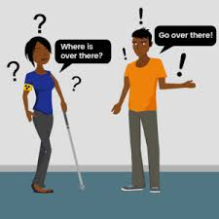
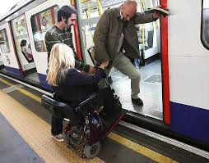
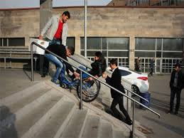
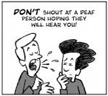
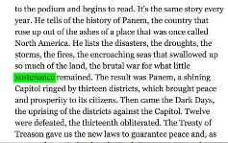

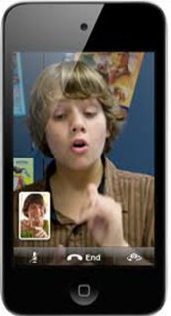
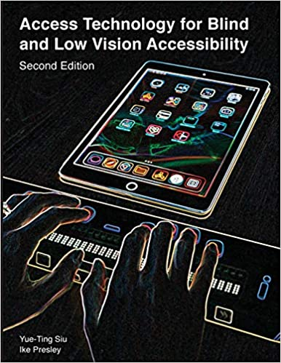
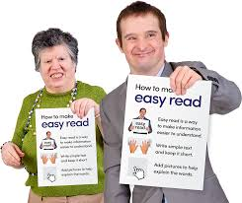
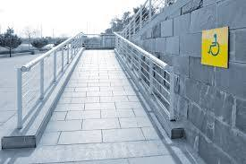
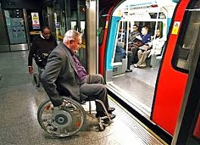

Rights and wrongs of access

Slide 10
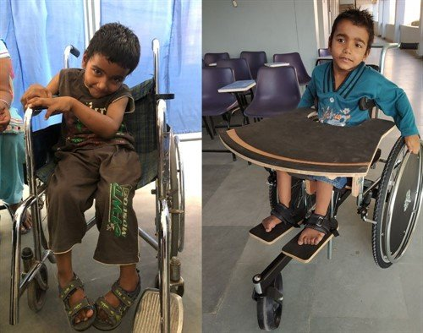
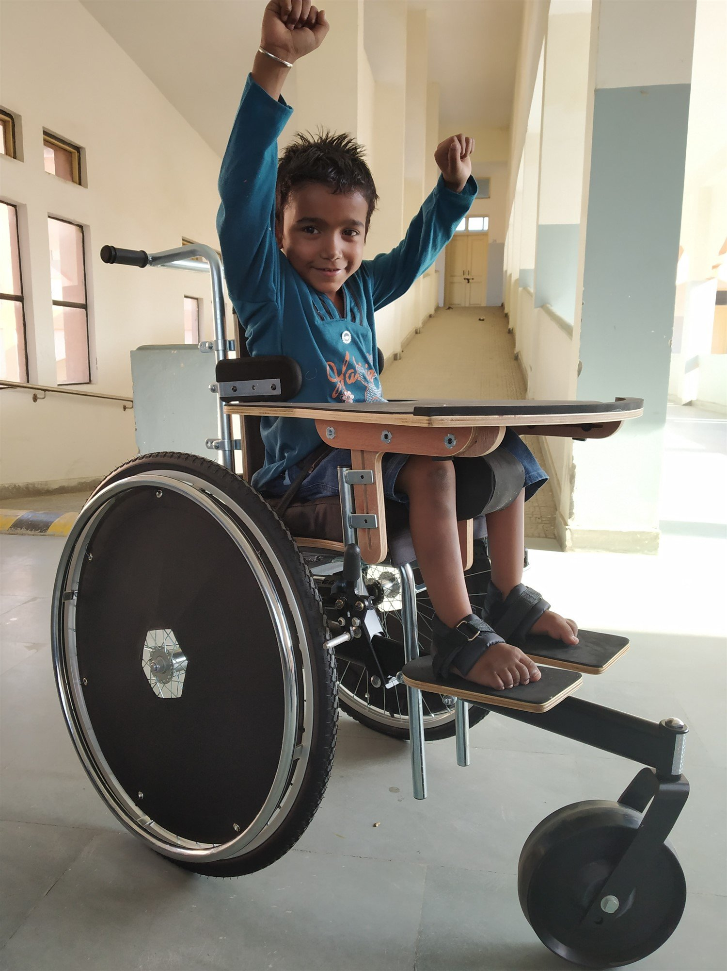
Hajot, Amritsar,India –Why My Wheelchair is vital
He has cerebral palsy; he can speak and understand, but he cannot walk and has weak hands. When Harjot was three and half years old his father died, and his mother abandoned him because of his impairment .
Before receiving support from Motivation, Harjot was supported by carers. He used to crawl to get around, which was hurting his hands and legs. He is also unable to sit upright without support, so he couldn’t use his hands for other tasks. Harjot was given a wheelchair, but it was too big for him. He couldn’t push himself, and when someone else moved him around in it he felt unstable.
After receiving a Moti-Go wheelchair from Motivation, Harjot is very happy and is able to
move around by himself. He now has good postural support, which means he can use his hands
for other tasks. And, thanks to the removable tray on his new wheelchair, he is now able to eat by himself, and participate in school activities. Now he has high hopes for his future
“Without this wheelchair I was unable to sit straight and always seeking help from someone. Now I can sit on my own, move on my own, live on my own. I want to study well and play well”.
https://www.motivation.org.uk/harjot-india

Slide 11
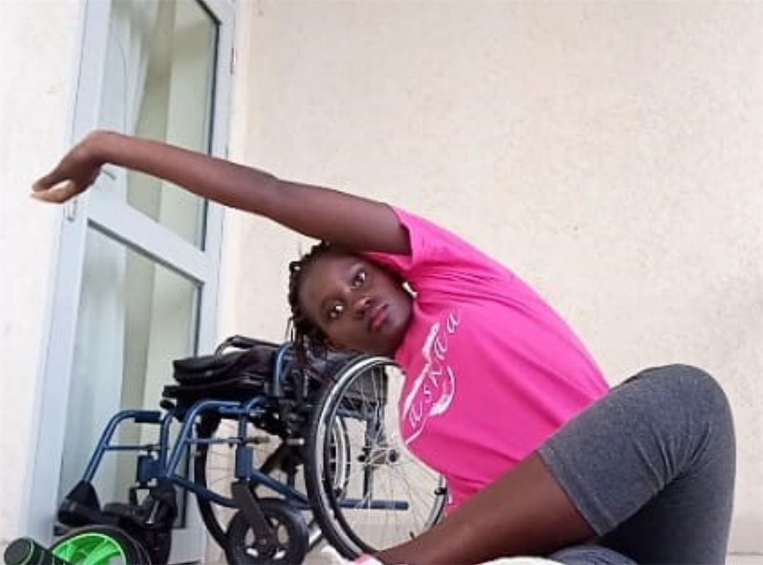
Stella, Nairobi, Kenya
Twenty-two year old Stella, from Nairobi, Kenya, was born with Spina Bifida. In 2018 she was fitted with a Motivation wheelchair and took part in our Job Seeking and Keeping Skills training.
During COVID-19 our Kenyan team caught up with Stella over the phone and heard about the challenges she was facing. She told us that “my studies have been paused, I can’t travel anywhere as am afraid to use public transport, because I will be putting myself at more risk of getting Coronavirus, as I need support to board the car, and currently it is very hard to access medical supplies like catheter that I need most”.
Stella has "recorded a video clip, which is circulating on social media, to support my peers on some of the exercises they can do at home to keep fit during this time of COVID-19 pandemic”. She felt this was important because “wheelchair user stay on the wheelchair for long, hence need some activities to keep them active and healthy, especially during the COVID-19 pandemic”.
https://www.motivation.org.uk/stellas-story

Slide 12
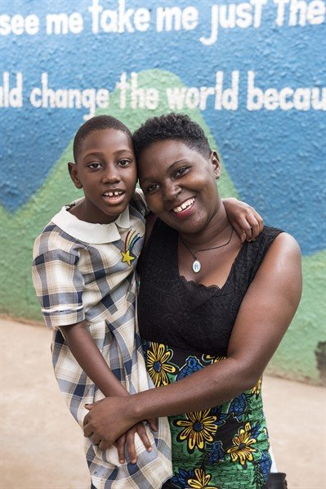
Waldah, Uganda
Waldah was just five months old when she was diagnosed with cerebral palsy. Family and friends believed the disability to be a curse, so they turned their backs on the baby and her mother, Lucy.
“The neighbours said I had produced a snake”.
Lucy's boss told her to choose between her child and her job. The pair had little hope for the future.
91% of disabled children in Uganda are not in school. Lucy tried to teach Waldah at home . She was lucky to find a school & teacher who could provide an inclusive classroom for Waldah amongst other children.
Through mixing and playing with other children Waldah can now, 3 years later, speak and feed herself and is learning at school.
Programmes like Motivation All Stars will help her and more disabled children to have a chance to work with sports coaches and transform their lives through sports and play, levelling the playing field for at least 270 disabled children in Uganda.
https://www.motivation.org.uk/all-stars-waldah

Slide 13
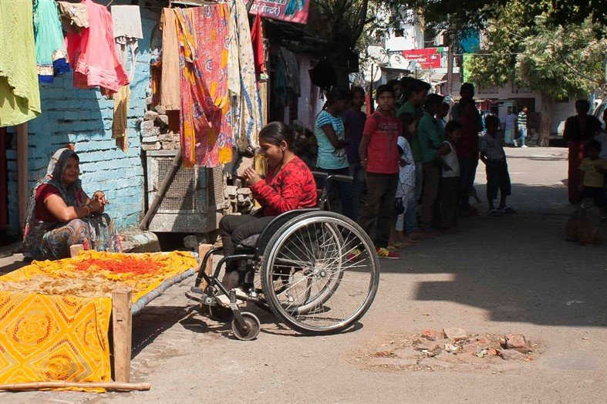
Anika, India
Stigma and discrimination around disability is rife. Disabled people are often excluded by their families, friendship groups and wider communities. They are treated unfairly by prospective employers, or aren’t given jobs at all.
Unable to access healthcare and prone to health complications that could be easily cured, conditions like pressure ulcers, respiratory problems and bladder infections can become life-threatening.
Anika was determined to be independent, educated and mobile. “I’ve had my Motivation wheelchair for around a year and a half now. I use it for tutoring students in their homes or visiting friends and family nearby. I think Indian society is very understanding and respectful to those with disabilities but accessibility problems do remain."
Motivation projects are establishing a network of services with 24 partners and more than 100 outreach partners. This means we’ll be able to reach thousands of disabled people across the country.
https://www.motivation.org.uk/india

Slide 14
Accessible India Campaign

Slide 15
Moving Beyond Disability
To Accessibility-India
Https://www.youtube.com/watch?v=E7SV9Kw2YpE&feature=youtu.be
Department of Empowerment of Persons with Disabilities (DEPwD) has launched Accessible India Campaign (Sugamya Bharat Abhiyan) as a nation-wide Campaign for achieving universal accessibility for Persons with Disabilities (PwDs). It has the following three important components: http://imaic.nic.in/
Email accessibleindiacampaign@gmail.com
An estimated 1% of the world's population, or just over 75 million people, need a wheelchair. In most developing countries, few of those who need wheelchairs have access, production facilities are insufficient and wheelchairs are often donated without the necessary related services.

Slide 16
Assistive Devices
Assistive technology : The application of organized knowledge and skills related to assistive products, including systems and services. Assistive technology is a subset of health technology.
Way forward on supply of assistive devices
States should formulate policies and laws to support the development, production, distribution and servicing of assistive products.
2) States should ensure that assistive products are available and affordable for disabled people including through a provision of grants.
3) Incentivise research on and the development of assistive technology.
4). Ensure that disabled people and their families obtain knowledge on available assistive products and schemes from which they can benefit.
5) Measures should be taken to ensure that assistive products can be used effectively, such as hearing loops for hearing aid users. In addition to accessibility, assistive products need to meet the preferences and expectations of a user to be effective.
6) Monitor unmet needs for assistive technology to identify and fill the gaps.

Slide 17
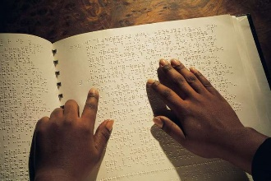
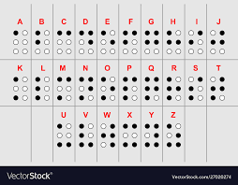
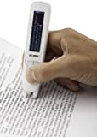
Access for Visually Impaired and Blind People
Braille (1824) a universally accepted system of writing used by and for blind people and consisting of a code of 63 characters, each made up of one to six raised dots arranged in a six-position matrix or cell. These Braille characters are embossed in lines on paper and read by passing the fingers lightly over the manuscript.
Magnifying glass and glasses help many visually impaired people see to read letters.
An expensive tech solution is ZoomText . This software not only provides screen magnification but many other useful features, such as being able to manipulate colour texts and other elements which are displayed for easier viewing.
JAWS, Job Access With Speech was the world’s most popular screen reader, developed for computer users whose vision loss prevented them from seeing screen content or navigating with a mouse. It is expensive. Last year NVDA replaced it as the most popular. Non Visual Desktop Access (NVDA) is a free, open-source, portable screen reader for Microsoft Windows.
Text to speech on computer as standard is massively improving access.Mobile devices such as C –Pen Reader (right)

Slide 18
Marrakesh Treaty
Copywrite law was preventing blind and other print impaired people from making copies of published books and articles in various formats such as Braille that they could then access for information, study or enjoyment.
The Marrakesh Treaty was signed in Marrakesh Morocco on June 27, 2013
This is an international instrument that addresses the right to read, particularly focusing on blind and visually impaired persons and people with print disabilities.
The World Intellectual Property Organisation (WIPO) administered Treaty makes the production and international transfer of specially-adapted books for people with blindness or visual impairments easier.
This Treaty must be ratified by Governments and when this is done, they are to amend their traditional Copyright Laws thus enabling persons with print disabilities to access reading materials including books at their leisure.

Slide 19
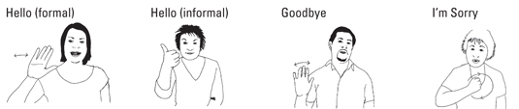
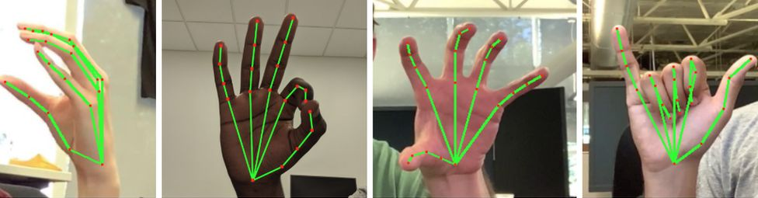
Access for Deaf People and deafened people
Pre-lingually Deaf people have for many years had their own Sign Language with many country and regional varieties. It has its own grammar and gesture and body posture is also utilised. A standardised language with dictionary is important.
The UNCRPD prioritises access to sign language though there are many oral means of communication with enhanced hearing aids and implants.
The limits on Deaf people are caused because many people do not know or understand sign. Mobile smart phones helping with remote interpretation.
Recently technology is being developed to read sign language translate to text on computer this should help many Deaf people . Google Sign

Slide 20
The Importance of Sign Language

Slide 21
Access Hard of Hearing/Deafened-Steve Estey

Slide 22
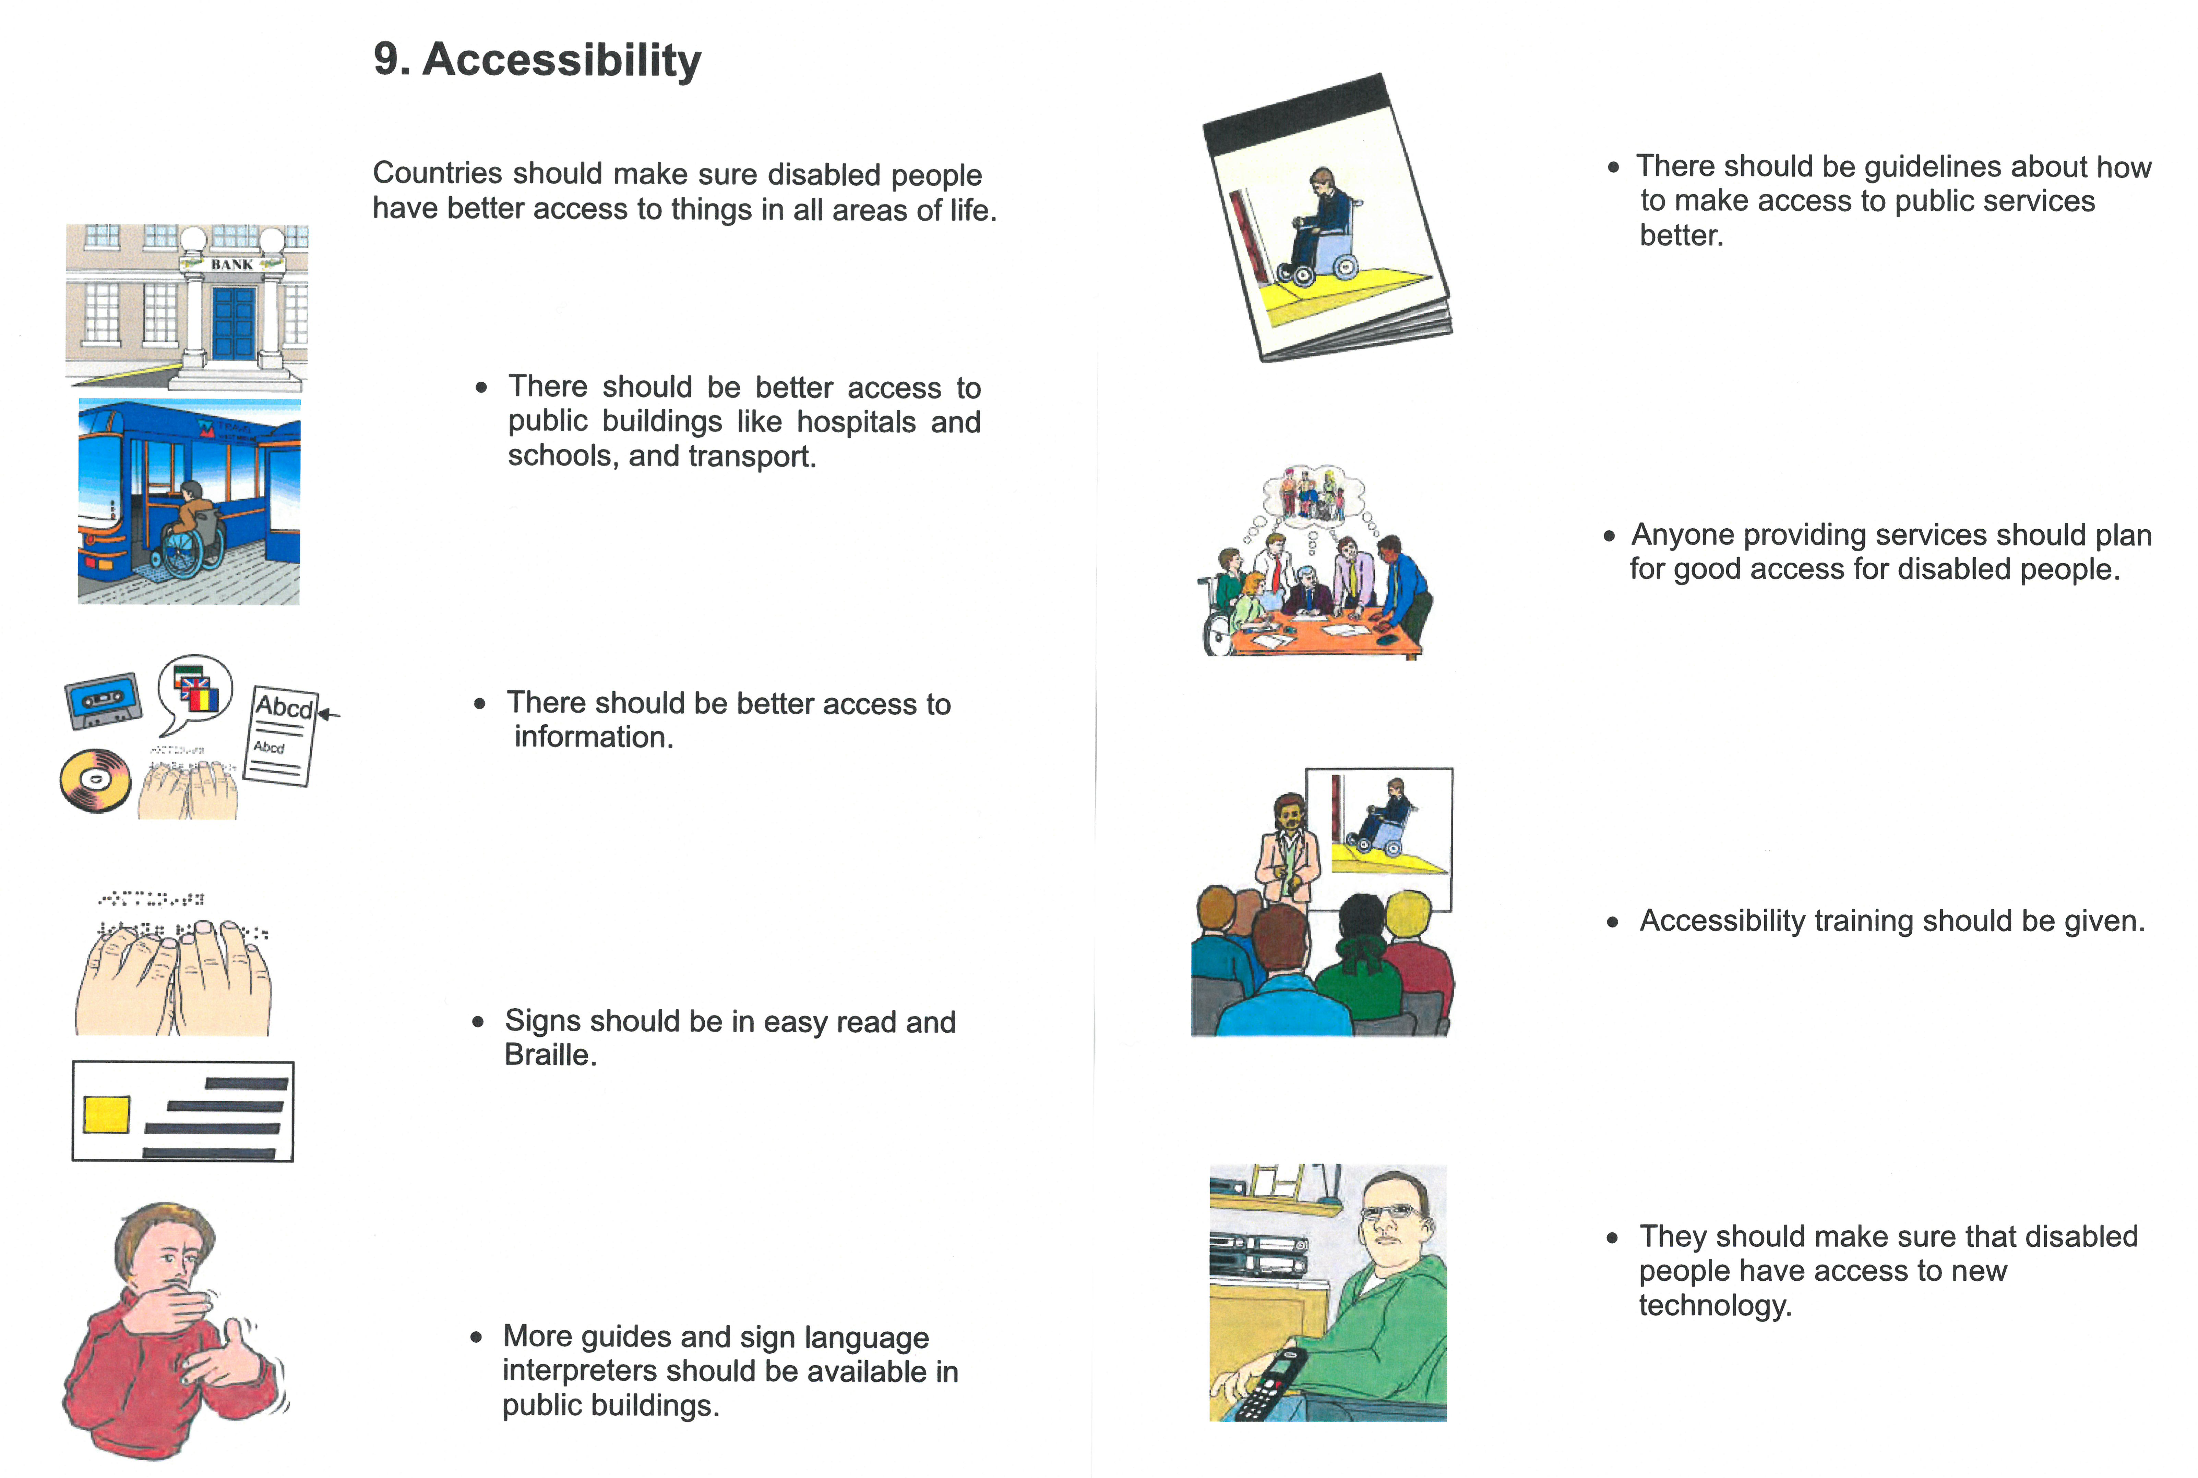
Plain Language Easy Read and Pictograms
https://assets.publishing.service.gov.uk/government/uploads/system/uploads/attachment_data/file/345108/easy-read-un-convention.pdf

Slide 23
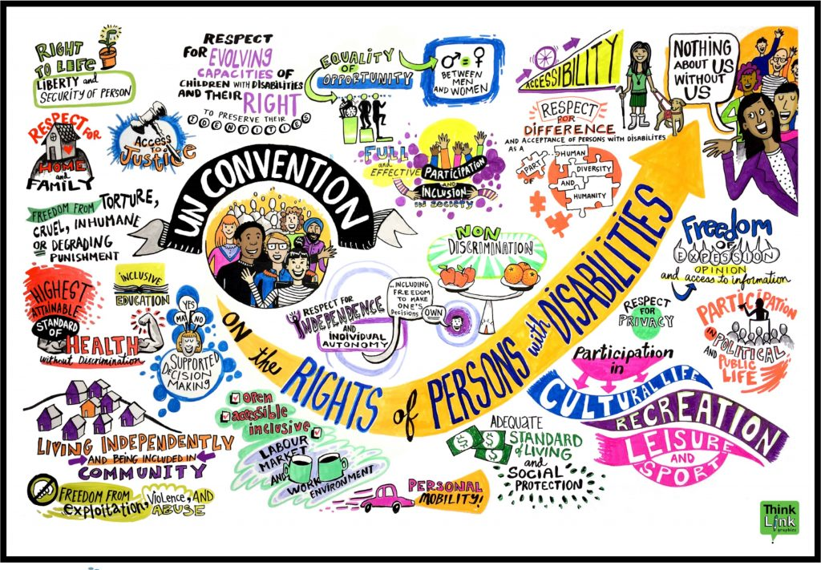
Arch Disability Law Centre ,CA, USA
https://archdisabilitylaw.ca/initiatives/advancing-the-un-crpd/

Slide 24
Universal Design
“Universal design” means the design of products, environments, programmes and services to be usable by all people, to the greatest extent possible, without the need for adaptation or specialized design. “Universal design” shall not exclude assistive devices for particular groups of persons with disabilities where this is needed”. Article 2 UNCRPD.
Principles of Universal Design
1. Equitable Use -The design is useful and marketable to people with diverse abilities.
2. Flexibility of Use -The design accommodates a wide range of individual preferences and abilities.
3. Simple and Intuitive Use -The design is easy to understand, regardless of the user’s experience, knowledge, language skills, or current concentration level.
4. Perceptible Information- The design communicates information effectively to the user, regardless of ambient conditions or the user’s sensory abilities.
5. Tolerance for Error- The design minimizes hazards and the adverse consequences of accidental or unintended actions
6. Low physical effort -The design can be used efficiently and comfortably and with a minimum of fatigue.
7. Size and Space for Approach and Use -Appropriate size and space is provided for approach, reach, manipulation, and use regardless of user's body size, posture, or mobility.

Slide 25
Case Studies Jamaica
Jamaica Persons who are blind or visually impaired will benefit from assistive technology to help them access the Internet. This is being facilitated by the Government under the Caribbean Community (Caricom) Trade and Competitiveness Project (CTCP), which is aimed at contributing to the deepening of the regional integration process.(2016)
The assistive software will be available through the Jamaica Council for Persons with Disabilities (JCPD).
The JCPD also participated in a strategic planning workshop for the development of a virtual relay interpreting system to enhance communication for deaf persons. The workshop was organised by the Jamaica Association for the Deaf through its ‘Advancing Deaf Kids Jamaica’ project. The initiative aims to advance the rights and protection of deaf children and young people through a nationwide programme of communication, safe behaviour and positive parenting by utilising sports and dance as channels for engagement.
Minister of Labour and Social Security, Shahine Robinson noted that the Ministry, through the JCPD, will continue to advocate for the rights of persons with disabilities and ensure that they are included in Government’s plans and policies

Slide 26
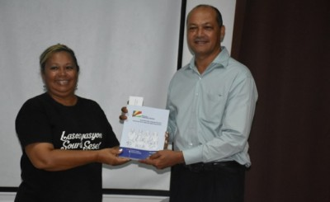
Case Study Seychelles The Deaf & hearing-impaired community in Seychelles has its own sign language dictionary for the first time
The dictionary was launched last Saturday after 10 years of work(Dec 2019), in a ceremony held at the Citizenship Engagement Platform (CEPS) in Victoria, the capital.
When presenting the dictionary, Annie Risler from the University of Lille, said that “it is intended to follow the local signs and thus promote their dissemination. I t is also a valuable tool for young deaf people to meet sign language for the first time and a valuable tool for deaf students and their teachers.”
The publication was made possible through a partnership agreement between the National Institute for the Young Deaf in Paris (INJS), the Association of People with Hearing Impairment in Seychelles, the Ministry of Education and Human Resources Development and the University of Lille.
The chairperson of the Association of People with Hearing Impairment in Seychelles, Anita Gardner, said she is very happy and proud of the team that worked on the project. “We had our ups and downs but we were determined to finish it. As sign language is a right, our association felt it was our duty to make sure that happened. Now our job is to teach the whole population,”

Slide 27
Case Study Making Accessible Canada Act

Slide 28
Access What is to be Done?
1. DPOs to carry out a situational analysis to identify barriers to access not addressed, compliance with existing legislation and identify gaps in national legislation and implementation frameworks on accessibility, reasonable accommodations and assistive technology, compared to the requirements of the UNCRPD and the Sustainable Development Goals.
2. State parties and all levels of government to audit implementation of and compliance with existing Disability Legislation with regards to Accessibility Standards, which should include the physical environment, built environment including new or extensively modified public and private housing, public transport including road, rail, air and by boat. Review and amend primary and secondary legislation where found inadequate against international treaty commitments.
3. State parties to accelerate the full implementation of accessible ICT including by the provision of low-cost software and assistive devices for all persons with disabilities, Information and Communication including the development and promotion of the use of all accessible formats, such as Sign language, Captioning, Braille and Easy Read, alternative and augmentative modes of communication and adopt capacity-building programmes for translators and/or interpreters. For Blind and visually impaired and others who are ‘print disabled’, ensure the Marrakesh Treaty is fully incorporated into national legislation to allow copywrite material to be available in alternative formats.
4. State parties to implement national and state law on accessibility, by taking a cross-sectoral approach, requiring all ministries engaged in public infrastructure to address accessibility in all planning and implementation processes

Slide 29
5. State parties to ensure compliance with article 9 of the UNCRPD and National Legislation on Accessibility and a right to redress in the justice system to enforce:-
a) legally binding accessibility action plan, with benchmarks, indicators and timelines, to cover all aspects of the built environment, public service provision, information and communications, including sign language interpretation, as well as assistive listening systems;
b) progressively developing the operational measures to implement accessibility;
c) the accessibility of transportation services, including transport concessions and licences with no additional charging for those who use taxis because they cannot use public transport;
d) the Information and Communication Technology Policy to provide access to information and technology for persons with disabilities on an equal basis with others, ensuring assistive devices are readily available;
e) the provision of remedy for persons with disabilities and introduce sanctions in case of non-compliance, including infrastructural projects by foreign investment;
f) strengthening of enforcement mechanisms in the public and private sector and ensure adjustment orders are issued to non-compliant stakeholders;
g) setting a time frame and targets for implementing access to caption services and descriptive video content for mainstream media, websites and social media;
h) compliance with internationally recognised standards of access and provision of assistive devices;
i)require Universal Design standards in new products and infra-structure developments.

Slide 30
Access What is to be Done? 3
6. State parties to develop effective monitoring and reporting
7. State parties should take measures to ensure that the technology and services necessary for the repair and manufacturing of quality mobility aids, assistive devices, be made available locally and at an affordable cost,
8. State parties should support the teaching, use and development of their national sign language for Deaf people and deaf/blind people and ensure sufficient sign interpreters are trained and available, that for those who are hard of hearing hearing-aid technology is widely and cheaply available.
9. State parties should ensure teaching and information is provided accessibly to those with learning difficulty and psycho-social impairments, in ways and environments that are conducive to their comprehension.

